Slide 1
Movie Ticket Booking System
A Database Management Project
Team Members :
RA2311030010317 T. Yashwanth
RA2311030010283 L. Koushik

Slide 2
Problem Definition
Objective: Develop an SQL database to manage movie ticket bookings, including movies, theaters, showtimes, seats, and customer bookings.
Challenges:
- Managing multiple theaters and screens.
- Handling real-time seat availability.
- Ensuring secure booking and payment processing.

Slide 3
Entities & Relationships
Relationships:
One movie is shown in multiple theaters (1:M)
One theater has multiple screens (1:M)
One screen has multiple showtimes (1:M)
One showtime has multiple seats (1:M)
One customer can make multiple bookings (1:M)
One booking is for one showtime (M:1)
One booking reserves multiple seats (1:M)

Slide 4
Entities & Attributes
Movies:movie_id, release_date
Theaters: theater_id, name, location
Screens: screen_id, theater_id, capacity
Showtimes: showtime_id, movie_id, screen_id, start_time
Seats: seat_id, screen_id, seat_number, availability
Customers: customer_id, name, email, phone
Bookings: booking_id, customer_id, showtime_id, seat_id, payment_status

Slide 5
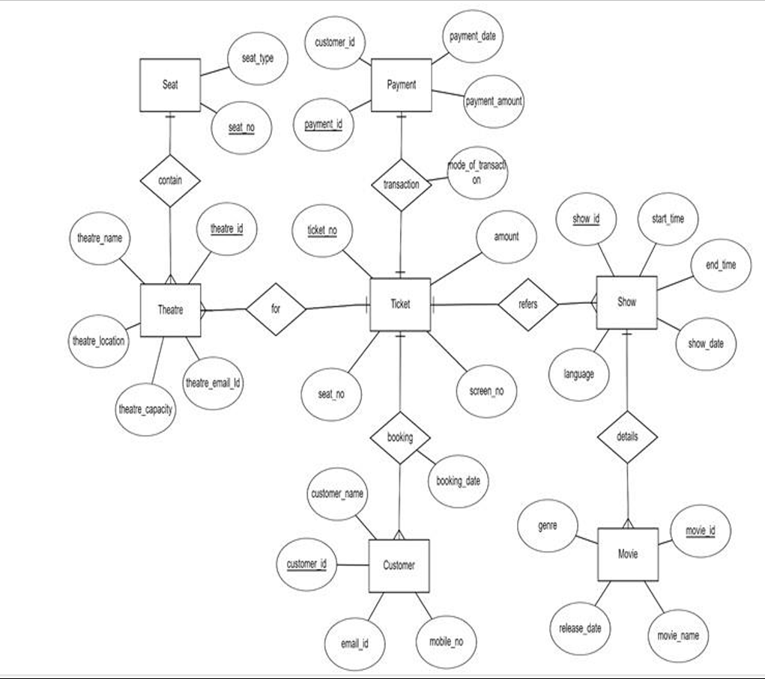
ER Diagram

Slide 6
Physical Design (SQL Schema)
Tables:
- Movies
- Theaters
- Screens
- Showtimes
- Seats
- Customers
- Bookings

Slide 7
Example Query
SELECT movies.title, theaters.name, showtimes.start_time
FROM showtimes
JOIN movies ON showtimes.movie_id = movies.movie_id
JOIN screens ON showtimes.screen_id = screens.screen_id
JOIN theaters ON screens.theater_id = theaters.theater_id
WHERE theaters.name = 'Cineplex 10';

Slide 8
Conclusion
Key Takeaways:
- Well-structured database design
- Efficient querying for seat availability
- Secure booking and payment processing
Future Scope:
- Integration with payment gateways
- Mobile app for bookings
- AI-based seat recommendations

